Slide 1
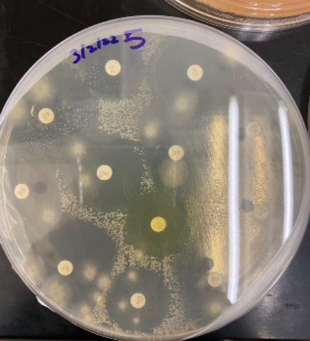
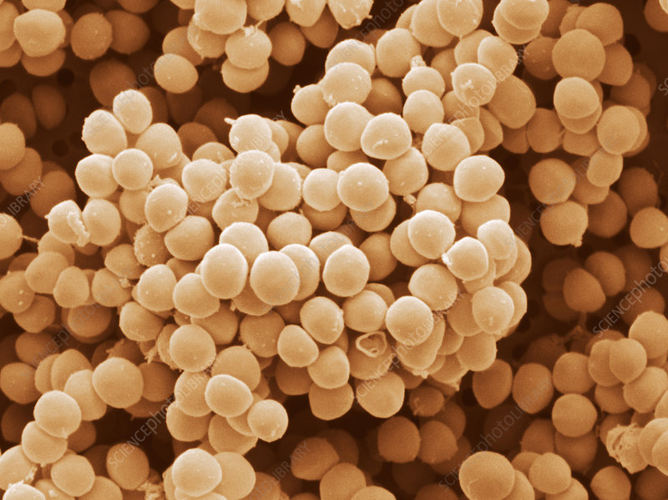
Searching for the Powerful Enemy:
Investigating Antimicrobial Resistance in New York City Medical Facilities
Leanne Auyeung¹, Peter Goswami², and Mangala Tawde³
¹Bronx High School of Science; ²Stuyvesant High School; ³Queensborough Community College, CUNY.
Abstract
This study was conducted to determine the presence of antibiotic resistant bacteria on high touch surfaces in different types of healthcare facilities since antibiotic resistance in microbial pathogens potentially found in healthcare facilities can be a grave concern. Our findings indicated that there was no significant correlation between the level or type of healthcare facilities and how resistant or susceptible the isolated bacteria are to antibiotics. However, they indicated that antibiotic resistant bacteria may be prevalent in a wide array of healthcare facilities, so majors to mitigate microbial resistance is important.
Results
 | Location | Surface | Species | Resistant to:
Organism 1 | Urgent Care Center | Door Handle | Bacillus megaterium | Cefoxitin, Clindamycin
Organism 2 | Urgent Care Center | Door Handle | Kocuria indica | Cefoxitin, Chloramphenicol, Nitrofurantoin
Organism 3 | Dentist Office | Doorknob | Staphylococcus saprophyticus | Cefoxitin, Penicillin
Organism 4 | Doctor’s Office | Doorknob | Bacillus thuringiensis | Cefoxitin, Penicillin, Ticarcillin, Ceftriaxone
Organism 5 | Doctor’s Office | Doorknob | Bacillus sp. NRV | Cefoxitin
Organism 6 | Hospital Pharmacy | Doorknob | Staphylococcus hominis | Cefoxitin, Vancomycin, Penicillin, Ticarcillin
Organism 7 | Retail Pharmacy | Credit Card Pad | Ureibacillus massiliensis | Cefoxitin
Organism 8 | Hospital Entrance | Door Handle | (not sequenced) | Cefoxitin, Nitrofurantoin
Organism 9 | Dentist Office | Door Handle | Bacillus licheniformis | Cefoxitin, Clindamycin, Penicillin
Organism 10 | Hospital Entrance | Door Handle | Bacillus infantis | Cefoxitin
Organism 11 | Hospital Entrance | Door Handle | (not sequenced) | Cefoxitin, Nitrofurantoin
Organism 12 | Dentist Office | Door Handle | Halalkalibacterium halodurans | Cefoxitin, Clindamycin
Fig. 1. Photo of contaminated plate
Introduction
Antibiotic resistant bacteria and fungi cause 2.8 million infections and 35,000 deaths in the US each year (CDC, 2019)
Healthcare facilities tend to see a greater volume of patients and use antibiotic products at a large scale; therefore, healthcare facilities may have a significant amount of antibiotic resistant bacteria
We hypothesized that there would be a correlation between the level of medical facility (i.e. doctor’s office vs. hospital) and the level of antibiotic resistance as each see a different volume of patients and are exposed to different pathogens
COVID-19 pandemic has led to a higher influx of patients, possibly exposing more people to antibiotic resistant bacteria, making the issue of antibiotic resistance more relevant
Fig. 2. Photo of S. Saprophyticus. Image by Science Photo Library
Discussion
There was no significant correlation between the number of antibiotic resistant bacteria and different levels of healthcare facilities that they were isolated from. Resistant bacteria were found in all samples but most were resistant to FOX and sensitive to IPM.
Future experiments could compare antibiotic resistance in healthcare facilities before and after the COVID-19 pandemic or across a wider region, and help establish better guidelines for understanding antibiotic resistance in a wider range of bacterial species and expand the number and types of antibiotics tested.
Many of the bacteria sequenced were Bacillus, possibly due to their resistance and commonness. Bacillus can cause bacteremia, endocarditis, and meningitis. Other bacteria sequenced include K. indica, which is part of the normal microbiota in human skin and mucous membranes but can cause keratitis and meningitis. S. saprophyticus can lead to UTIs and epididymitis while S. hominis can lead to an opportunistic infection.
Possible sources of error include a fungal contamination in culture 5, long storage over the pandemic possibly affecting PCR reagents and antibiotics, unsuccessful sequencing of organisms 8 and 10 due to a low yield of DNA in PCR amplification, and inconclusive results on antibiotic sensitivity due to widely varying interpretation guidelines for different bacteria.
Materials and Methods
11 samples were collected from different medical facilities including urgent care centers, doctor’s offices, and hospitals by using sterilized cotton swabs and saline solution to swab surfaces.
After being cultured for three days, 12 colonies were isolated from a variety of these samples.
The Kirby Bauer test was performed to test for antibiotic resistance to 12 common antibiotics in these colonies.
DNA from these 12 colonies were extracted and the 16S rRNA gene was amplified via PCR to send out DNA for Sanger sequencing of 10 of these colonies.
Acknowledgements
We are grateful to The Pinkerton Foundation and Science Sandbox: An Initiative of the Simons Foundation for funding our project. We thank Drs. Allison Mayle and Arden Feil and the DNA Learning Center Community for supporting us and Dr. Mangala Tawde for mentoring us in our research endeavors.
References
Centers for Disease Control and Prevention. (2021, November 23). 2019 Antibiotic
Resistance Threats Report. Centers for Disease Control and Prevention. May 22, 2022,
https://www.cdc.gov/drugresistance/biggest-threats.html
Hardy Diagnostics . (n.d.). HARDYDISK™ Antimicrobial Sensitivity Test (AST). May
22, 2022, https://catalog.hardydiagnostics.com/cp_prod/Content/hugo/HardyDiskASTProceduresandChart.pdf
Hudzicki , J. (2009, December 8). Kirby-Bauer Disk Diffusion Susceptibility Test Protocol.
ASM. May 22, 2022, https://asm.org/getattachment/2594ce26-bd44-47f6-8287-0657aa9185ad/Kirby-Bauer-Disk-Diffusion-Susceptibility-Test-Protocol-pdf.pdf
Reed, J. (n.d.). The Truth About COVID-19 and Black Fungus. Pfizer. May 22, 2022,
https://www.pfizer.com/news/articles/the_truth_about_covid_19_and_black_fungus
Reynolds, J. (n.d.). 9: Kirby-Bauer (Antibiotic Sensitivity). May 22, 2022,
https://bio.libretexts.org/Learning_Objects/Laboratory_Experiments/Microbiology_Labs/Microbiology_Labs_I/09%3A_Kirby-Bauer_(Antibiotic_Sensitivity)
Turnbull, P. C. B. (1996). Bacillus. In S. Baron (Ed.), Medical Microbiology. University
of Texas Medical Branch at Galveston. May 22, 2022, https://www.ncbi.nlm.nih.gov/books/NBK7627/.

