Slide 1


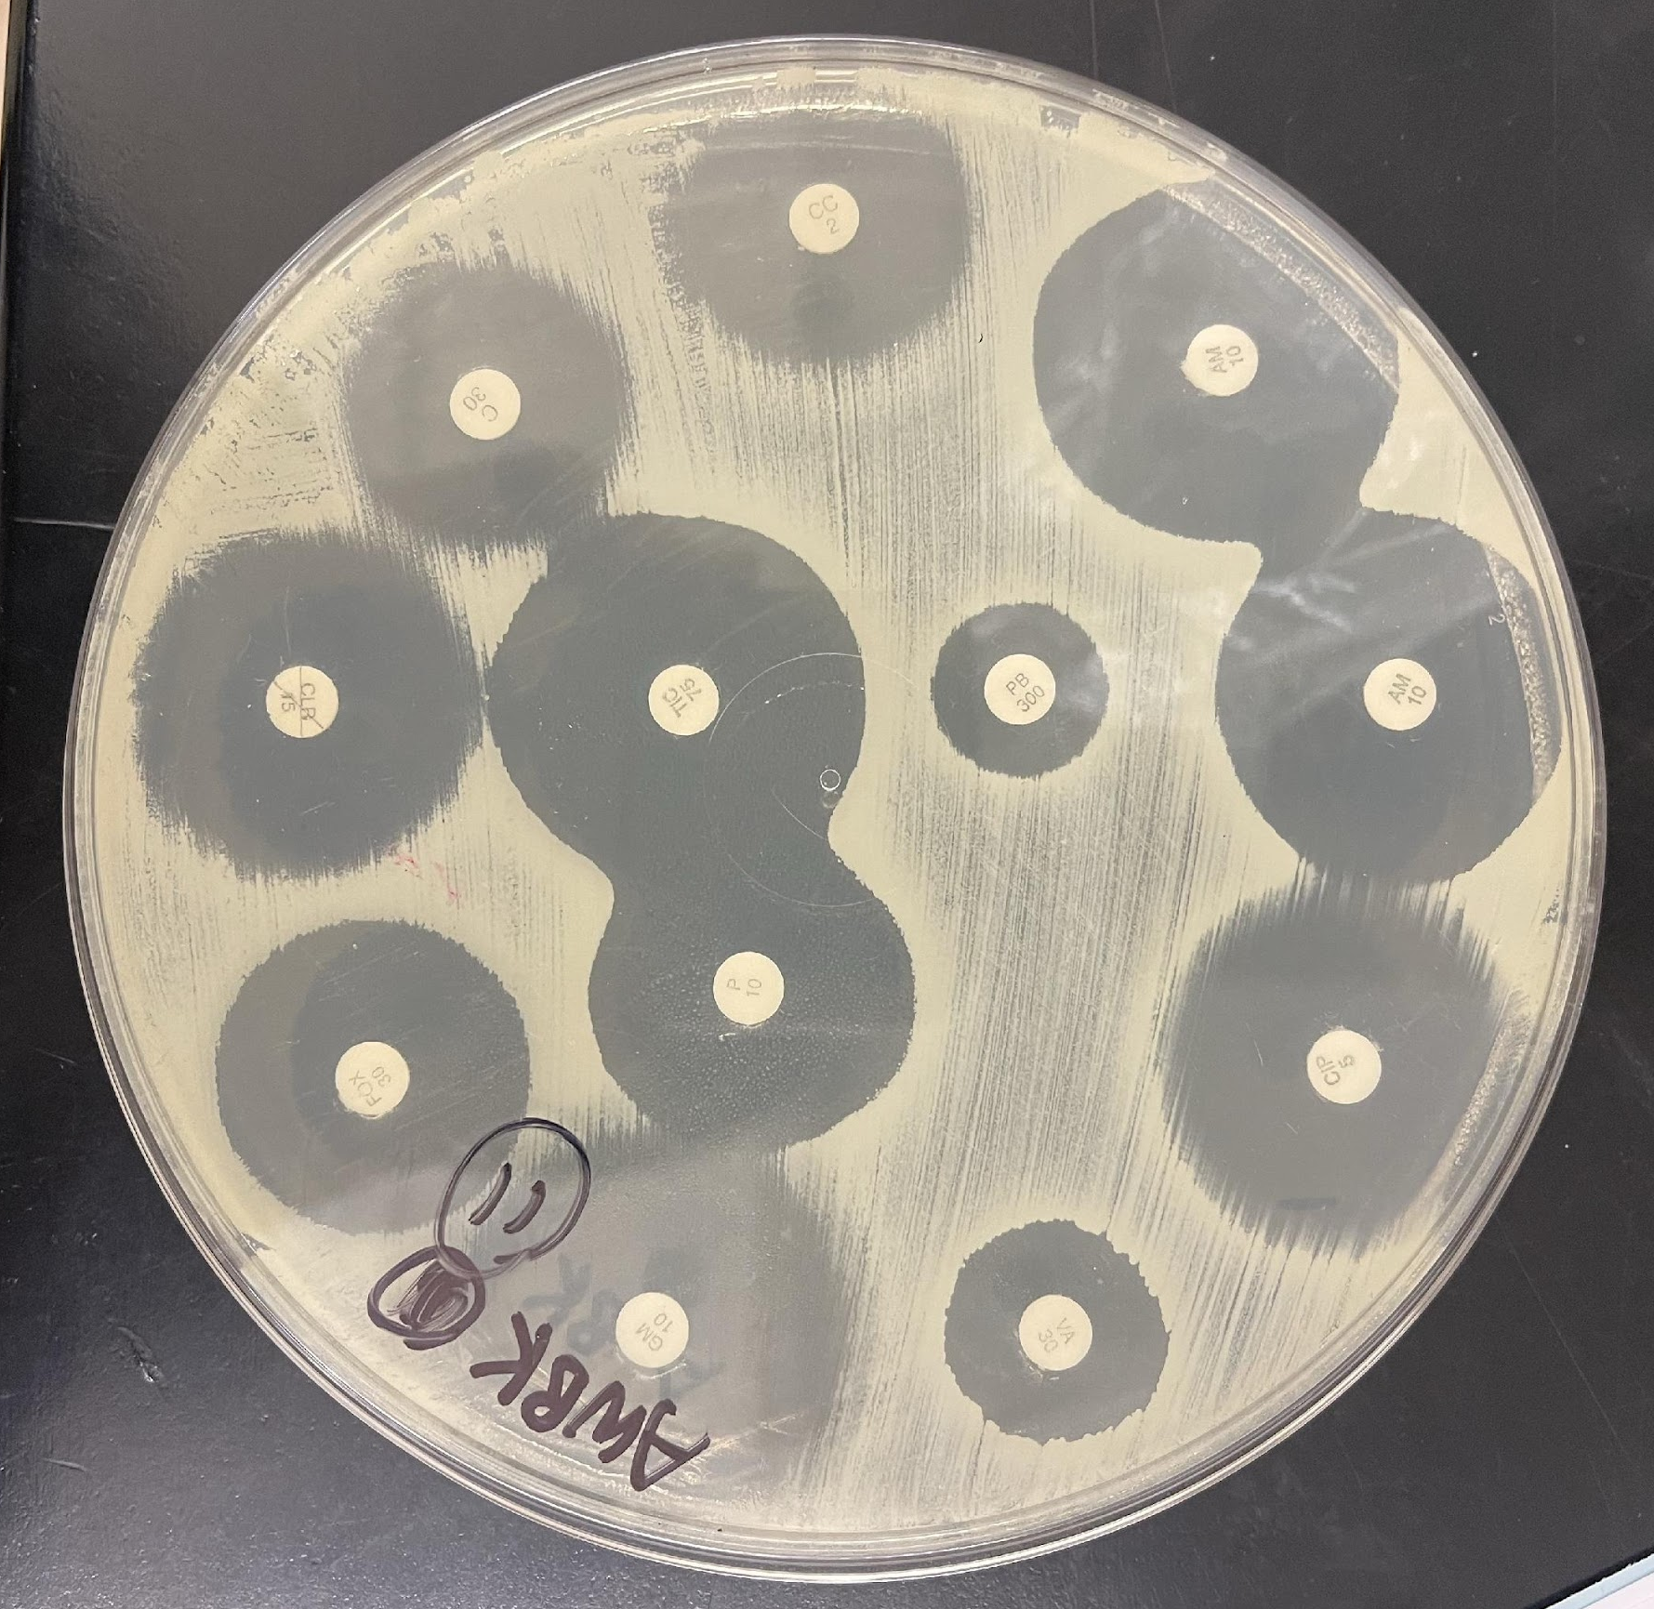
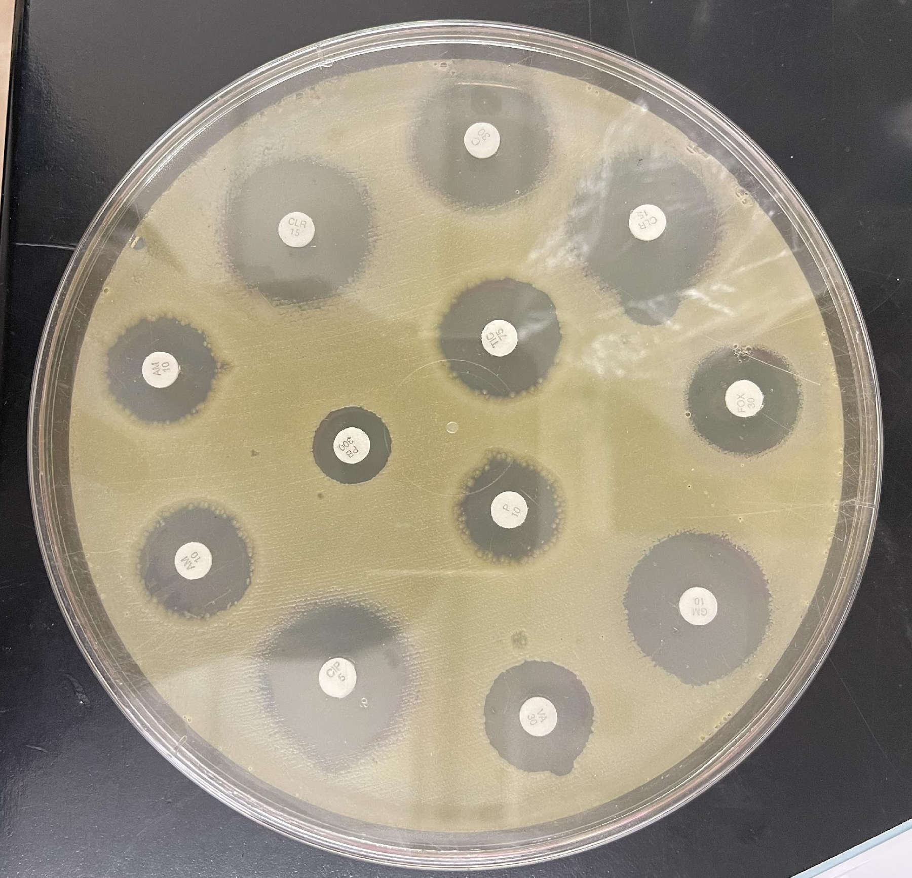
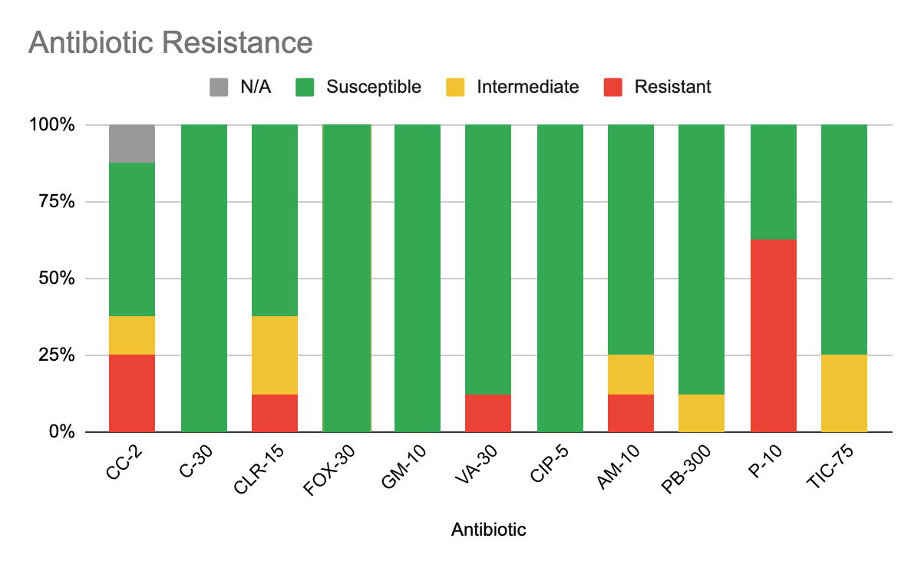
Bacteria Busters! Antibiotic Resistance of Bacteria Found in Public vs. Private Modes of Transportation
Authors: Basant Kaur¹, Angela Wang²,
Mangala Tawde³
The Berkeley Carroll School¹, Hunter College High School², Queensborough Community College³
Funded by the
Thompson Family Foundation
Abstract
The MTA has introduced new cleaning measures to mitigate the spread of COVID-19. However, these measures could be rendered useless due to the increasing number of antibiotic-resistant bacteria in the environment. The goal of our experiment was to identify what mode of transportation contains more antibiotic-resistant bacteria and which antibiotics could be most effective against these bacteria. Our team hypothesized that there may be more antibiotic-resistant bacteria in public modes of transportation compared to private modes of transportation due to the difference in biodiversity. Bacteria were isolated from various modes of transportation and grown using standard methods. The Kirby-Bauer assay was then used to analyze bacterial susceptibility/ resistance to antibiotics. Our data supported the hypothesis, as the bacteria from public transportation were more likely to be resistant to antibiotics. Many bacterial isolates were found to be Penicillin-resistant; while cefoxitin, chloramphenicol, gentamicin, and ciprofloxacin were highly effective against most bacteria.
Material & Methods
    Swab samples were collected from four different modes of transportation using a sterile swab: MTA subway, MTA buses, the LIRR trains, and personal cars.
    Swabs were streaked onto agar plates and incubated at 37°C for 48 hours to grow bacteria colonies. Selected bacteria colonies were further grown in nutrient broth.
    DNA extraction was done using Qiagen DNeasy PowerSoil DNA Isolation Kit. 16s rDNA amplification was carried out by PCR. Agarose gel electrophoresis was performed to ensure amplification of correct amplicon, which were sequenced and identified.
    The Kirby Bauer disk diffusion method was used to analyze the antibiotic resistance/susceptibility of the bacteria isolates. Individual bacteria were streaked onto Muller-Hinton agar plates, and then different antibiotic disks were placed onto the agar plates. After 48 hours later, the bacteria colonies grew with circles of varying diameters around the antibiotic disks. The diameters of these “Zones of Inhibition” were measured to check for antibiotic resistance.
Discussion
  The majority of antibiotics were effective in preventing bacterial growth, especially C-30, FOX-30, GM-10, and CIP-5, which all had a 100% efficiency rate.
  More than half of the bacteria were resistant to penicillin, which may suggest that penicillin is not effective against many bacteria strains.
  Because of the disproportionate way that samples were tested (there were many car floor samples and few subway samples), it is difficult to tell if our hypothesis is correct. However, the bacteria samples with the most antibiotic resistance are from the bus and subway, which are public modes of transportation and support our hypothesis.
  Surprisingly, we have 5 uncultured bacteria samples. Since we sampled from places that do not get cleaned often, it is possible that uncultured bacteria could be found there.
  We were not able to test the antibiotic resistance of 4 bacteria samples (including ones from the LIRR) because the bacteria either did not grow in the broth or on the agar plate. We are not completely sure why, but it is most likely because of minor mistakes in the lab (e.g. not swabbing the agar plate completely), which we will avoid in future experiments.
Figure 1: Organism 11
(Uncultured bacterium
Clone) growing on
agar plate
Figure 2: Organism 10
(Uncultured bacterium
Clone) growing on
agar plate
Introduction
With the higher usage of antibiotics, bacteria tend to mutate and may harbor antibiotic-resistance genes. As soon as new antibiotics are introduced, bacteria subsequently gain resistance to these antibiotics very quickly. As a result, almost all known bacteria develop resistance to antibiotics (Li et al., “Bacterial Resistance”). Antibiotic-resistant bacteria present a challenge for global health, as they limit treatment options for infectious diseases (World Health Organization, “Microbial Resistance”). New York City’s transportation systems have been criticized for a very long time for their unsanitary conditions due to equipment breakdowns and worker shortages (Green, “We Finally”). Because of the COVID-19 pandemic, the MTA increased cleaning measures to reduce the spread of disease (Metropolitan Transportation Authority).
Our team collected bacteria samples throughout public and private modes of transportation in NYC and tested the antibiotic resistance of these samples. Our guiding question was, “Which modes of transportation have the most/least antibiotic-resistant bacteria?” We hypothesize that there will be more antibiotic-resistant bacteria species in public modes of transportation than private modes of transportation because there is likely more bacterial biodiversity in public transportation due to the much greater exposure to people of areas such as train compartments and buses. We also aimed to identify any antibiotics that are not sufficiently effective in cleaning transportation systems and ones that are very effective.
Results: Bacteria Identification
 | Location | Surface | Species | Resistant to:
Organism 1 | Bus | Floor | Rummeliibacillus stabekisii | (Not tested)
Organism 2 | Bus | Floor | Uncultured marine bacterium* | None
Organism 3 | Bus | Floor | Staphylococcus coagulans | None
Organism 4 | Bus | Floor | Pantoea hericii | Clindamycin, Vancomycin, Penicillin
Organism 5 | Car | Floor | Bacillus sp. | (Not tested)
Organism 6 | Car | Floor | Bacillus sp. | (Not tested)
Organism 7 | Car | Floor | Desemzia incerta | (Not tested)
Organism 8 | Car | Floor | Uncultured bacterium clone* | Penicillin
Organism 9 | Car | Floor | Bacillus sp. | Penicillin
Organism 10 | Car | Handle | Uncultured bacterium clone* | Penicillin
Organism 11 | Subway | Pole | Uncultured bacterium clone* | None
Organism 12 | Subway | Pole | Uncultured staphylococcus sp. clone* | Clindamycin, Clarithmomycin, Penicillin, Ampicillin
References
Green, Dennis. "We Finally Know Exactly Why the New York City Subway Is so Dirty." Business Insider. Accessed May 20, 2023. https://www.businessinsider.com/why-the-nyc-subway-is-so-dirty-2015-5.
Li, Ting, Zhenlong Wang, Jianhua Guo, Cesar De la fuente-nunez, Jinquan Wang, Bing Han, Hui Tao, Jie Liu, and Xiumin Wang. "Bacterial Resistance to Antibacterial Agents: Mechanisms, Control Strategies, and Implications for Global Health." Science of the Total Environment 860 (February 2023): 160461. https://doi.org/10.1016/j.scitotenv.2022.160461.
Metropolitan Transportation Authority. "How we're cleaning during the coronavirus pandemic." MTA. Last modified October 2020. Accessed May 20, 2023. https://new.mta.info/coronavirus/cleaning.
World Health Organization. "Antimicrobial Resistance." World Health Organization. Last modified November 17, 2021. Accessed May 20, 2023. https://www.who.int/news-room/fact-sheets/detail/antimicrobial-resistance.
Acknowledgments
Thank you to the Pinkerton Foundation, Queensborough Community College, and the Cold Spring Harbor Laboratory for their resources and support. Special thanks to Dr. Mangala Tawde for her amazing guidance and mentorship throughout this whole project!

