Slide 1




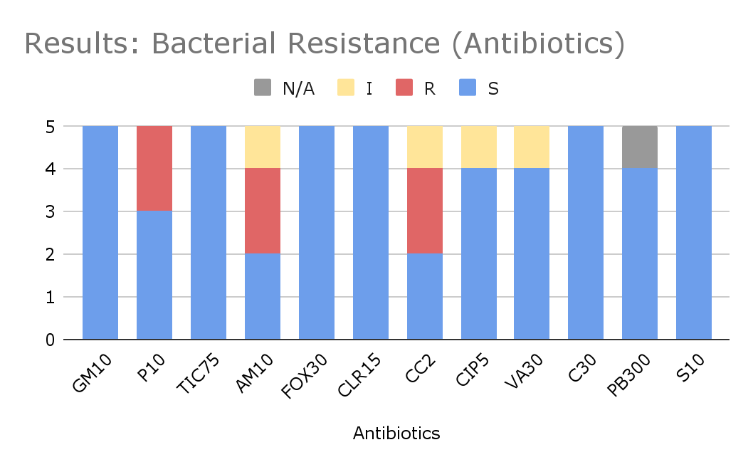
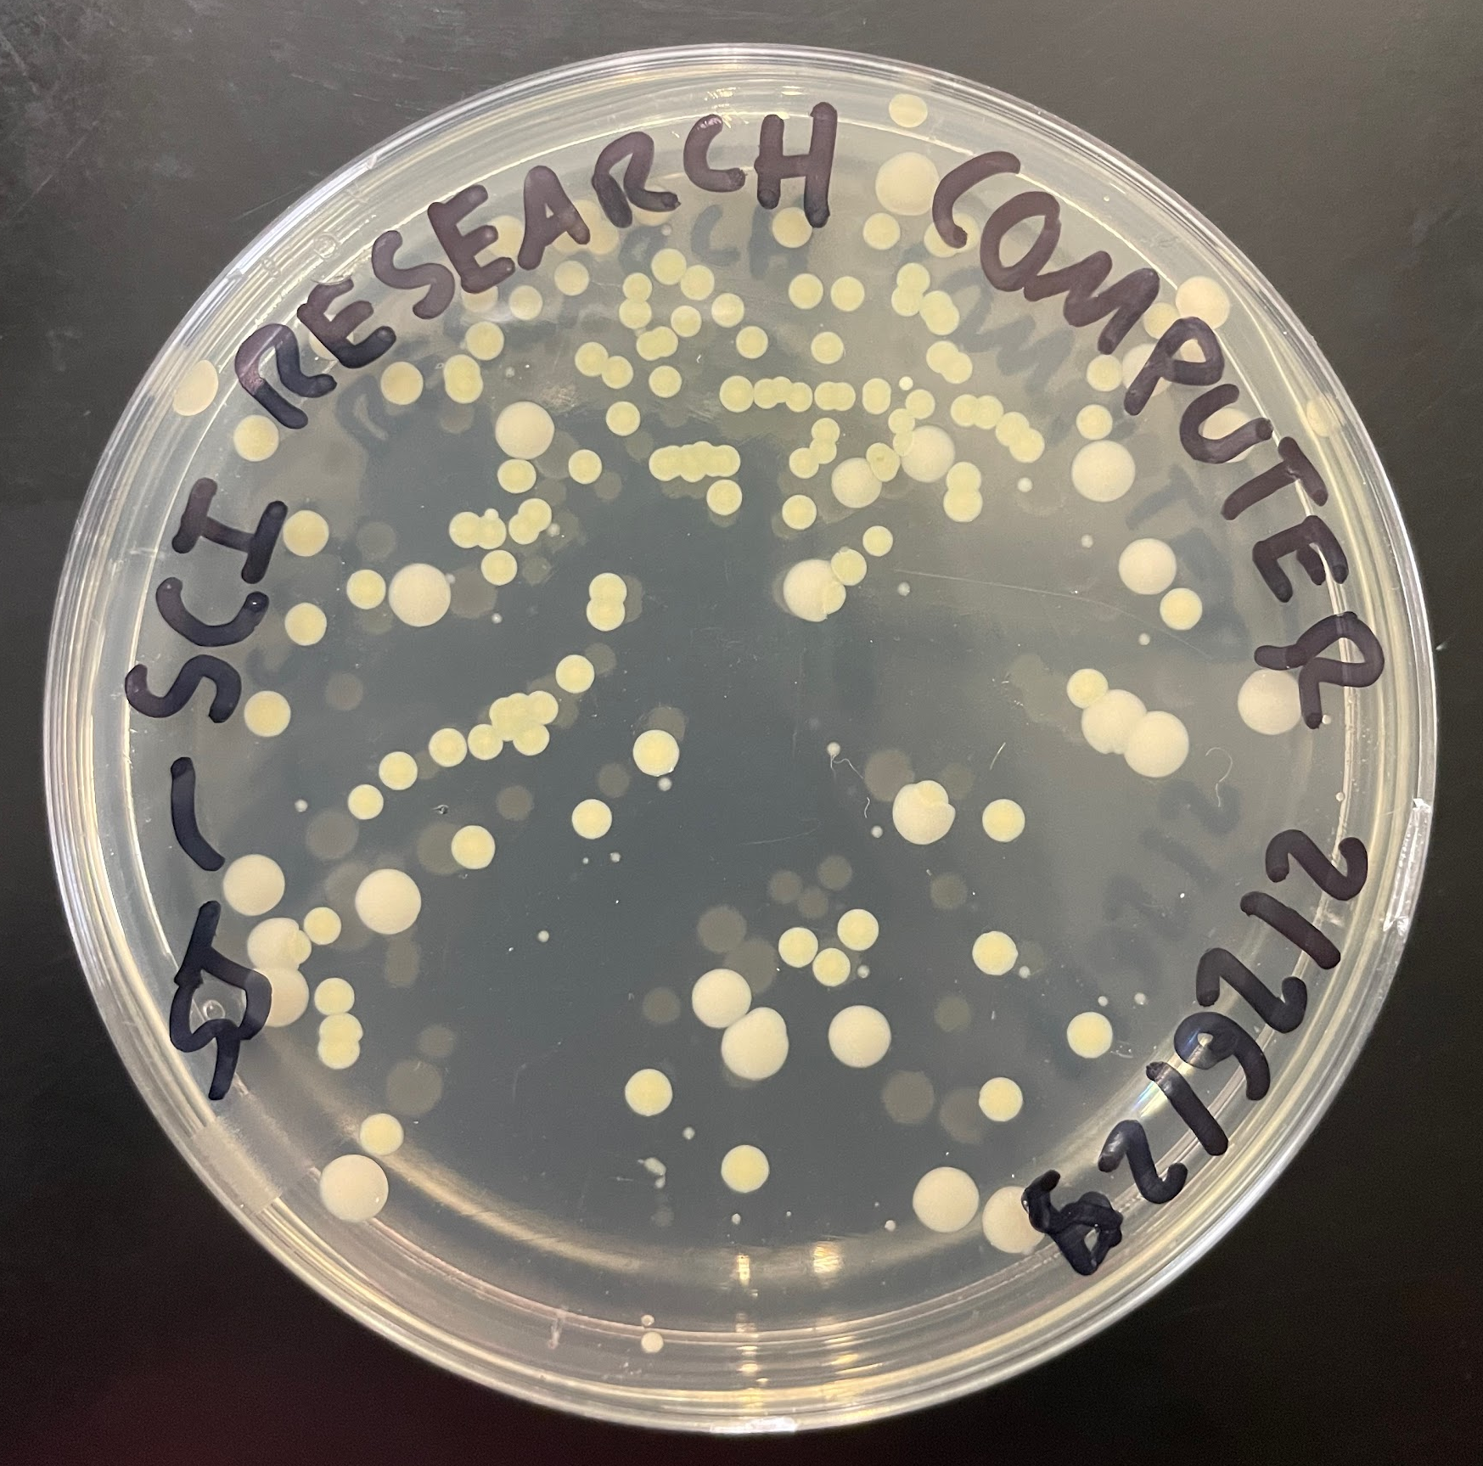
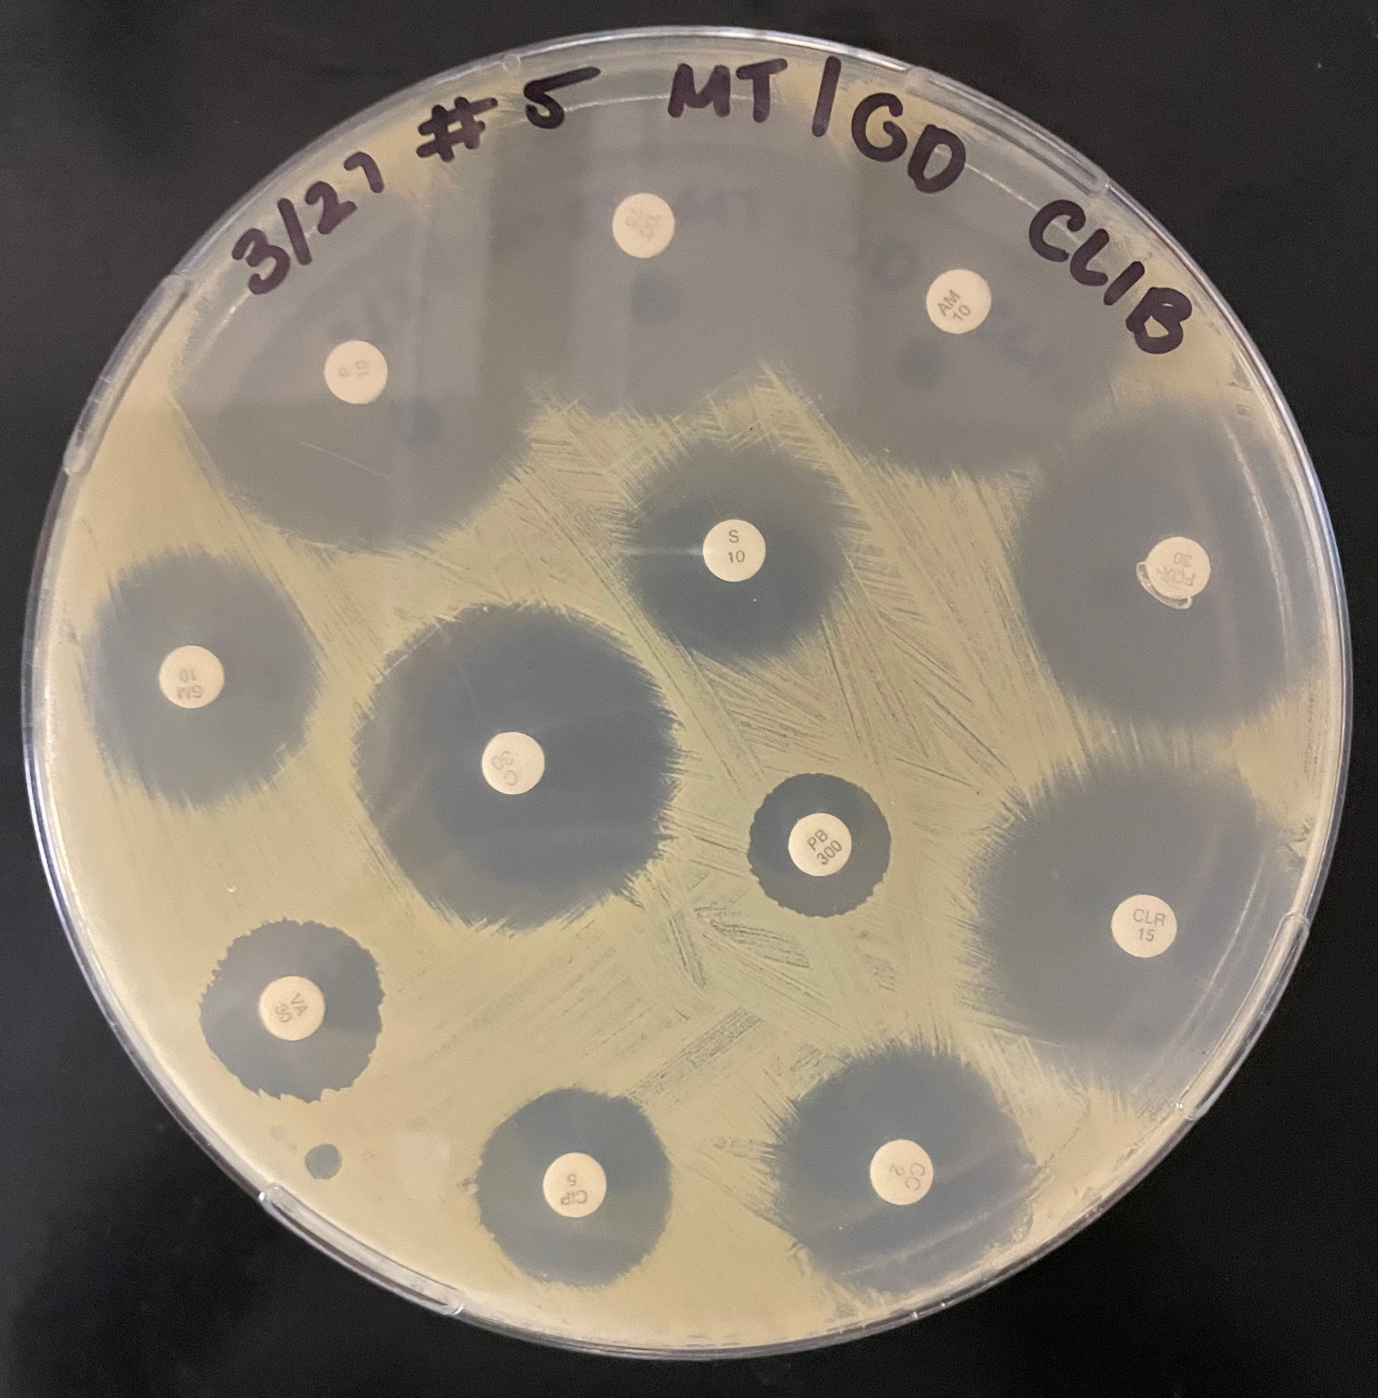
Classroom Contaminants: Uncovering Antibiotic-Resistant Bacteria on Devices in NYC Public Schools
Authors: Geetika Das¹, Saniha Jasrah², Samantha Das³, Mangala Tawde⁴
Benjamin N. Cardozo High School¹, Townsend Harris High School^{2,} Hunter College High School³,
Queensborough Community College⁴
In this research project, we aim to examine shared electronic devices in NYC public schools by sampling the bacteria and testing their antibiotic susceptibility to understand the the bacterial spread that has fascinated the scientific community. Microbial transmission takes its path through fomites, like phones, tablets, laptops, and computes. Many New York City public school students share these communal devices, enabling potential bacterial pathogens to spread quickly through student populations, impacting students’ health and learning. The devices’ surfaces will be swabbed to collect, isolate and identify bacteria via DNA barcoding. Antibiotic susceptibility will be tested using the Kirby-Bauer assay. The results of this investigation will help influence sanitation procedures in schools and raise awareness of pathogenic transmission among students.
Step 1: Sample Collection
A collection of 10 samples from three NYC public high schools, each sample being one of a different technological device found, whether communal or personal devices used on school grounds. Each sample was collected using a distilled water-moistened sterile swab a day or two before streaking.
Step 2: DNA extraction and PCR
The samples will be streaked onto a nutrient agar plate and the bacterial colonies will be grown on the agar plates at 37°C for 24-48 hours. 12 bacterial colonies will be isolated and grown in broth media to create liquid cultures. Qiagen DNA extraction kits were used to extracted 16s ribosomal DNA that was amplified through Polymerase Chain Reaction (PCR) for the 16s ribosomal DNA gene. The amplified DNA was analyzed using an agarose gel electrophoresis to ensure the PCR successfully amplifies the desired DNA fragments. The amplicons were then sent for DNA sequencing to identify each bacterial species. The sequence DNA will be compared to a public database to determine the identification of the tested bacterial samples.
Step 3: Antibiotic Resistance Testing
The isolated species of bacteria was tested for antibiotic resistance using the Kirby Bauer Disk Diffusion Assay, which consists of a set of commonly used antibiotics in clinical medicine. 5 isolated bacteria were selected and evenly streaked across Mueller-Hinton agar plates to create a bacterial lawn. Then, the disks soaked in the different antibiotics were stamped onto the bacterial lawn. The plates were incubated at 37°C for 24-48 hours to test the resistance/susceptibility of bacteria to the antibiotics. By analyzing the zone of inhibition for each antibiotic being tested, we determined the level of resistance by each bacterial species. The diameter of zones of inhibition was measured from the disk to determine the specific antibiotic susceptibility.
Abstract
Methodology
Among three public schools across New York City, most bacteria, sampled from communal electronic devices widely accessed by student bodies, were found to be susceptible to various common antibiotics. This suggests that schools are potential hotspots for microbial transmission. Regular disinfection of shared devices could help prevent future resistance from emerging illnesses and infections.
Among 60 antibiotic trials across 5 bacterial colonies, there were 10 trials that showed in antibiotic resistance or intermediate susceptibility. One trial was inconclusive.
All bacterial isolates were susceptible to antibiotics GM10, TIC75, FOX30, CLR15, C30, and S10; thus they were effective against all bacteria.
Some bacteria showed resistance against antibiotics P10, AM10, CC2, CIP5, and exhibited antibiotic resistance or intermediate susceptibility to VA 30.
Isolate #2 and #6 were found to be antibiotic resistant to P10, exhibiting a 60% effectiveness. Despite the well established usage of Penicillin, this experiment concluded how its as not an effective general treatment.
Isolate #5 and #6 was found to be antibiotic resistant and isolate #2 was intermediate-susceptible to AM10. AM10 was 40% effective. This strongly indicates the need for further development of novel antibiotics.
Isolate #2 and #6 CC2 were found to be antibiotic resistant and isolate #6 was in colony #2 and colony #6 and #8 was found to be intermediate-susceptible to CC2 demonstrating a 40% effectiveness.
Iolate #8 was was found to be intermediate-susceptible ito CIP 5; which is an 80% effectiveness.
Technology plays a dominant role in our lives as we have become inseparable from our devices. As technology advanced, our dependence on it also increases. From communication, entertainment, to education, electronic devices met those needs for humans (Hoehe & Thibaut, 2020).
Around 97% of students and educators integrate computers, smart boards, and smartphones daily (Radesky et al., 2023). Its usage is a reliable and efficiency way to convey information to students. However, this changed how adolescents learn. Most education systems have incorporated technology as a key support for teaching and learning (Szymkowiak et al., 2021).
Unfortunately, with the widespread use of devices, there is increased bacterial transmission, leading to the development of bacterial infections (Akinyemi et al., 2009). One study found 92.9% of smartphones presented evidence of bacterial contamination of various species of bacteria (Martina, et al. 2019) with 62% of phones are contaminated with pathogenic bacteria.
This widespread presence of bacteria indicates antibiotic-resistant bacteria. In a study focusing on drug-resistant bacteria on devices in an educational setting in Ghana, it was found there was an 83.3% contamination of bacteria of mobile phones and 43.3% contamination of computer keyboards, with a higher concentration of Staphylococcus epidermidis (Taiwo, et al. 2021).
While both pathogenic and antibiotic-resistant bacteria on students’ smartphones have been researched thoroughly, limited attention has been placed on the possibility of finding pathogenic bacteria found on other communal devices that are heavily shared among student populations.
By analyzing the relevance of certain bacteria species across communal educational devices, this study intends to fill the gap by identifying pathogenic antibiotic-resistant bacteria in schools carried by smartphones and other devices.
Figure 1: Colony — (Initial agar plate growth)
Figure 2: Colony 5
(Kirby Bauer Assay on Mueller-Hinton agar plate)
Discussion
Introduction
Results: Bacteria Identification
 | Location/Surface | Species | Resistance
# 1 | BNCHS HBS (1) | Priestia megaterium | [not tested]
# 2 | BNCHS HBS (2) | Kocuria marina | Penicillin (P10) & Clindamycin (CC-2)
# 3 | BNCHS BI (1) | Staphylococcus saprophyticus | [not tested]
# 4 | BNCHS BI (2) | Peribacillus frigoritolerans | [not tested]
# 5 | BNCHS Library (1) | Bacillus massiliglaciei | Ampicillin (AM-10)
# 6 | BNCHS Library (2) | Staphylococcus hominis | Penicillin (P10), Ampicillin (AM-10), Clindamycin (CC-2)
# 7 | HCHS Keyboard B (1) | Ureibacillus massiliensis | [not tested]
# 8 | HCHS Keyboard B (2) | Bacillus licheniformis | No resistance found. Intermediate to Ciprofloxacin (CIP-5)
# 10 | HCHS Keyboard B (3) | Bacillus infantis | No resistance found. Intermediate to Clindamycin (CC-2)
# 12 | HCHS Keyboard B (4) | Bacillus halodurans | [not tested]
References
Akinyemi, K. O., Atapu, A. D., Adetona, O. O., & Coker, A. O. (2009, September 15). The potential role of mobile phones in the spread of bacterial infections | The Journal of infection in developing countries. The Journal of Infection in Developing Countries. https://www.jidc.org/index.php/journal/article/view/19801807
Al Momani, W., Khatatbeh, M., & Altaany, Z. (2019, March 1). Antibiotic susceptibility of bacterial pathogens recovered from the hand and mobile phones of university students. Germs. https://pmc.ncbi.nlm.nih.gov/articles/PMC6446487/
Hoehe, M. R., & Thibaut, F. (2020, June). Going digital: How technology use may influence human brains and behavior. Dialogues in clinical neuroscience. https://pmc.ncbi.nlm.nih.gov/articles/PMC7366947/
Kõljalg, S., Mändar, R., Sõber, T., Rööp, T., & Mändar, R. (2017, June 1). High level bacterial contamination of secondary school students’ mobile phones. Germs. https://pmc.ncbi.nlm.nih.gov/articles/PMC5466825/
Martina, P. F., Martinez, M., Centeno, C. K., VON Specht, M., & Ferreras, J. (2019, December 20). Dangerous passengers: Multidrug-resistant bacteria on hands and mobile phones. Journal of preventive medicine and hygiene. https://pmc.ncbi.nlm.nih.gov/articles/PMC6953443/
Szymkowiak, A., Melović, B., Dabić, M., Jeganathan, K., & Kundi, G. S. (2021, March 29). Information Technology and gen Z: The role of teachers, the internet, and technology in the education of young people. Technology in Society. https://www.sciencedirect.com/science/article/abs/pii/S0160791X21000403
Radesky, J. S., Weeks, H. M., Schaller, A., Robb, M. B., Mann, S., & Lenhart, A. (2023). A week in the life of a young person’s smartphone use. Common Sense. https://www.commonsensemedia.org/research/constant-companion-a-week-in-the-life-of-ayoung-persons-smartphone-use-
Taiwo, M., Laryea, C. A., Kweku Mykels, D., & Forson, A. O. (2021, April 15). Multidrug-resistant bacteria on the mobile phones and computer keyboards of Healthcare University Students in Ghana. The Canadian journal of infectious diseases & medical microbiology = Journal canadien des maladies infectieuses et de la microbiologie medicale. https://pmc.ncbi.nlm.nih.gov/articles/PMC8062198/
Tullus , K. (2011, June 19). Safety concerns of angiotensin II receptor blockers in preschool children. Archives of disease in childhood. https://pubmed.ncbi.nlm.nih.gov/21690106/
We are immensely thankful to Dr. Mangala Tawde, our mentor, for guiding and supporting us throughout this research project! We are extremely grateful to the Pinkerton Foundation, Queensborough Community College, and the Cold Spring Harbor Laboratory for providing the resources and the support.
Acknowledgements

