Slide 1




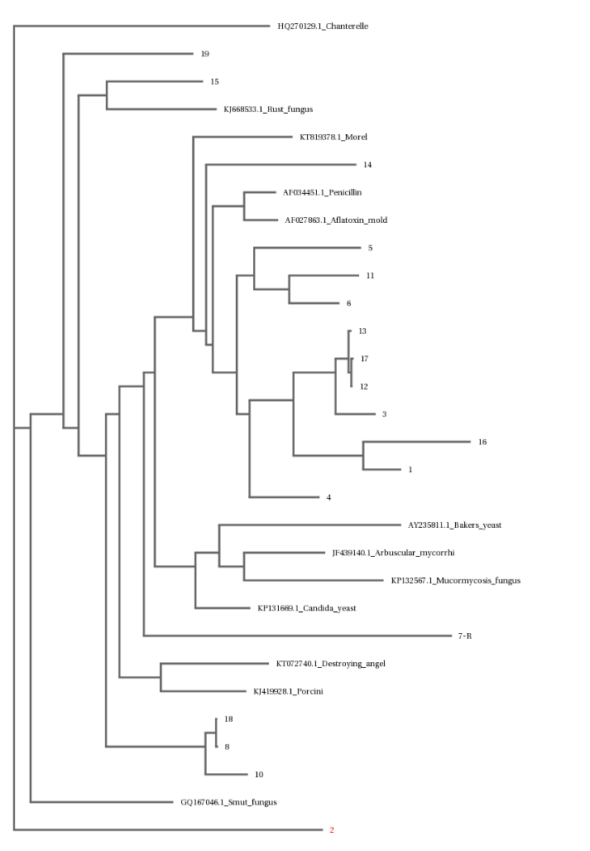
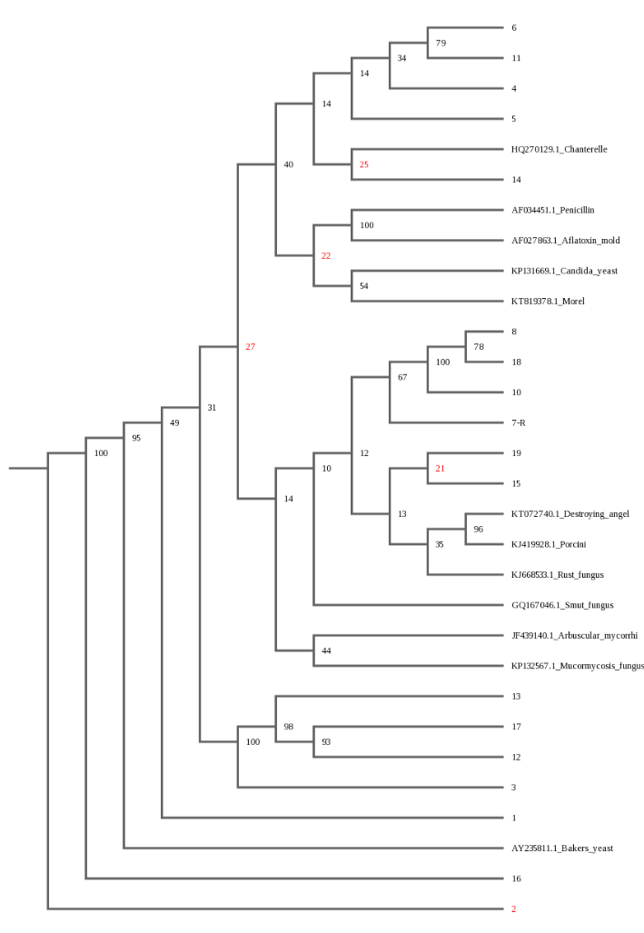
Lichen Biodiversity Representative of Environmental Health
Chris Dong¹, Zhu Zhao Bang², and Dr. Marianne Williams³
¹ Stuyvesant High School, ² Benjamin N. Cardozo High School, ³ Queensborough Community College
Abstract​
Results
In this study, we aim to determine the biodiversity of lichen (a symbiotic coexistence between a fungi and algae) species, determine relative levels of air pollution, and to measure the sensitivity of lichens to sulfur dioxide (SO2) air pollution in the Bayside neighborhood. Sulfur dioxide is a gaseous air pollutant formed when fuel containing sulfur such as coal, or oil is burned. Sulfur dioxide is known to inhibit natural processes such as photosynthesis, reproduction, and spore germination. This study gathered 20 lichen samples from two different parks (Crocheron Park and Alley Pond Park) located near busy highways. We performed DNA barcoding and compared identified species with databases that stated the lichen’s resistance to air pollutants. Although we expected some variation in the levels of air pollution sensitivity, most of the 10 species identified have intermediate tolerance. A diverse population of lichen species with a majority at least with an intermediate tolerance to SO2 pollution shows that many of the lichen species have adapted to their environments.
Lichens are technically two species, one algae and one fungi symbiotically coexisting with one other. DNA Barcoding was used to evaluate the samples collected. After extraction, we purified the DNA and ran Polymerase Chain Reaction to amplify it. After using gel electrophoresis to confirm that our DNA was usable, our team sent the DNA samples to a lab where they performed DNA sequencing through the use of fluorescent nucleotide bases and technology to determine what species of lichen the samples may have been. Samples 1 and 2 were identified to be the Physcia stellaris, which had intermediate sulfur dioxide tolerance. Samples 12, 13, and 17 were identified to be Phaeophyscia limbata with intermediate sulfur dioxide tolerance as well. Samples 8 and 18 were identified as Mycena meliigena with mild tolerance. Out of the 14 species identified, the study found that 5 samples were classified as “intermediate” in respect to SO2 resistance. 3 samples were classified as having “high” resistance. 3 samples were classified as having “mild” resistance. 1 sample was classified as “sensitive”, meaning that it did not handle SO2 pollution well. Different samples had varying bit scores or qualities of DNA alignment, with any bit score above 200 as very reliable. However, there were a decent amount of mismatches in our data because of the shear complexity of a lichen as it is two species (algae and fungi) symbiotically coexisting with one another.
Sample #​ | Identified Species​ | Bit Score​ | Mismatches​ | SO2 Tolerance​
1​ | Physcia stellaris​ | 791​ | 36​ | Intermediate​
2​ | Physcia stellaris​ | 930​ | 2​ | Intermediate​
4​ | Flavoparmelia baltimorensis​ | 654​ | 12​ | High​
5​ | Phaeophyscia rubropulchra​ | 725​ | 52​ | High​
6​ | Paranectria affinis​ | 699​ | 49​ | Mild​
8​ | Mycena meliigena​ | 1190​ | 8​ | Mild​
10​ | Mycena corticola​ | 841​ | 67​ | Sensitive​
12​ | Phaeophyscia limbata​ | 1026​ | 57​ | Intermediate​
13​ | Phaeophyscia limbata​ | 1070​ | 56​ | Intermediate​
14 ​ | Rhinocladiella sp.​ | 910​ | 40​ | Unknown ​
17​ | Phaeophyscia limbata​ | 1038​ | 58​ | Intermediate​
18​ | Mycena meliigena​ | 1231​ | 3​ | Mild​
19​ | Trichaptum biforme​ | 1217​ | 0​ | High​
20​ | Sporothrix schenckii​ | 535​ | 80​ | Unknown​
Introduction
Air pollution is defined as the contamination of the air with chemicals, compounds, or particulates that cause damage to the environment. Common air pollutants include nitric oxide (NO), nitrogen dioxide (NO2), and sulfur dioxide (SO2). Compared to rural environments, urban environments have higher levels of air pollution due to pollutants concentrated in industrial areas, high traffic density areas, and high building density areas (NYCCAS, 2020). This project aims to determine the air pollution levels in Bayside, Queens by sequencing and identifying lichen in the area. Lichens are symbiotic organisms consisting of fungi and algae. Lichens are bioindicators, organisms that indicate ecosystem health, because they are easily affected by pollutants. Lichens are non-vascular organisms meaning they accumulate air pollutants easily (NHM UK, 2020). According to Conti and Cecchetti, chlorophyll contents, photosynthetic processes, and cell membranes are damaged by air pollutants, such as SO2 and NO2, which can lead to the death or stunted growth of lichens (2000). This study researched the impact of sulfur dioxide (SO2) as the main pollutant. Bayside, Queens is a suburban area with several highways including the Cross Island Parkway and Horace Harding Expressway. Cars’ prolific use of these highways can lead to an increased amount of air pollutants in the area. The original hypothesis was if pollution was high, there would be a lack of biodiversity in the sampled lichen species.
Materials & Methods
Sample Collection:
10 samples of lichen were collected from Crocheron Park while another 10 samples were collected from Alley Pond Park. These parks were pre-determined via a thorough examination of parks near the Cross Island Parkway and are in a three mile radius. Lichen samples were gathered from trees, rocks, logs, and decaying matter by means of scraping into brown paper bags. The samples were later transferred into plastic Zip-Loc bags and stored in a freezer at -20℃.
DNA Extraction and Sequencing:
The Qiagen DNeasy Plant Mini Kit was used to isolate and purify twenty fungal DNA samples. Small specimen lichen samples were extracted from each plastic Zip-Loc and placed into Eppendorf tubes. Lysis solutions were added and samples were grinded until the supernatant changed color. Wash buffers, elution buffers, and centrifuges were used to isolate the DNA from the supernatant. After isolation, the DNA samples underwent polymerase chain reaction (PCR) to amplify the DNA. Then, the amplified DNA underwent gel electrophoresis to determine whether or not the samples were viable for sequencing.
Following the initial PCR procedure and sequence review, the team determined that samples 2, 3, 4, 5, 14, and 20 were not successful. The team decided to redo these samples with the DNeasy Plant Mini Kit and PCR procedures. Only lichen samples 2, 4, 5, 14, and 20 were relatively successful from this review. Ultimately, samples 3, 7, 9, 11, 15, and 16 were determined to either not be conclusive, could not be identified, or lacked enough nucleotide sequences.
Materials:
Qiagen® DNeasy Plant Kit: Buffer AP1 (960 µL), RNAse A (10 µL), Buffer P3 (320 µL), Buffer AW1 (~1620 µL), Buffer AW2 (2400 µL), Buffer AE (240 µL), QIAshredder Mini spin columns, DNeasy Mini spin columns, 2-mL Collection tubes, 96–100% Ethanol (quantity varies)*, Specimen tissue sample(s) (from Part I), Microcentrifuge tubes (1.5 mL), Ice bathes.
Discussion
The findings of the study ran counter to the initial hypothesis. There was not a limited amount of species found in the parks. Instead there were different species found. However, many samples also shared the same species classification. Specifically, Physcia stellaris, Phaeophyscia limbata, and Mycena meliigena were the species that samples repeatedly identified as. This may mean that these species are better adapted to the Bayside area and thrive well. As stated in the results, 5 samples were classified as having “intermediate” resistance while 3 samples were classified as “high resistance”. 8 of the 14 samples have at least an “intermediate” level of resistance, suggesting that the lichens in the Bayside area are adapted to a high level of SO2 concentration.
Only 14 samples were able to be identified out of the 20 samples gathered. There most likely was error in gathering samples, isolating DNA, and then amplifying that DNA or that it was difficult to extract the DNA from the hard lichen samples. This can be proven because the re-amplification of samples shed light on new species that we did not sequence before. The high bit scores in the samples show that the species identified are very similar to the sequences used to compare. Many of these samples also have a high mismatch rate. This could potentially be fixed by redoing the DNA extraction process. Lichens are notably difficult to work with even if proper ITS primers are used.
REFERENCES
Askham, B. “Nature and pollution: what lichens tell us about toxic air”. (2020, June ). Natural History Museum of London. https://www.nhm.ac.uk/discover/nature-and-pollution-what-lichens-tell-us-about-toxic-air.html
Azlan Abas. “A systematic review on biomonitoring using lichen as the biological indicator: A decade of practices, progress and challenges.” (2021). Ecological Indicators. Volume 121. ISSN 1470-160X, https://doi.org/10.1016/j.ecolind.2020.107197.
Cecchetti, G., Conti, M.E. “Biological monitoring: lichens as bioindicators of air pollution assessment — a review”. (2001). Environmental Pollution. Volume 114 (Issue 3). pages 471-492. https://doi.org/10.1016/S0269-7491(00)00224-4.
New York City Department of Health and Mental Hygiene. Queens College. (2020). “Neighborhood Air Quality 2008-2020”. The New York City Community Air Survey. https://nyccas.cityofnewyork.us/nyccas2022/report/3.
“Planning and Preparation”. DNA Learning Center Barcoding 101. https://dnabarcoding101.org/lab/planning-prep.html.
U.S. Forest Service. “Air Pollution Sensitivity Ratings for Macrolichens in the Western US”. National Lichens & Air Quality Database and Clearinghouse. https://gis.nacse.org/lichenair/?page=w_sensitivity
U.S. Forest Service. “Air Pollution Sensitivity Ratings for Macrolichens in the US Pacific NW”. National Lichens & Air Quality Database and Clearinghouse. https://gis.nacse.org/lichenair/?page=pnw_sensitivity
U.S. Forest Service. “Air Pollution Sensitivity Ratings for Macrolichens in the Eastern US”. National Lichens & Air Quality Database and Clearinghouse. https://gis.nacse.org/lichenair/?page=e_sensitivity
U.S. Forest Service. “Lichen Habitat”. United States Department of Agriculture. https://wmww.fs.usda.gov/wildflowers/beauty/lichens/habitat.shtml
U.S. Forest Service. “Lichen Collection and Identification”. United States Department of Agriculture. https://www.fs.usda.gov/wildflowers/beauty/lichens/identification.shtml
U.S. Forest Service. “Understanding air pollutants and air pollution effects on lichens: A Pacific Northwest perspective”. National Lichens & Air Quality Database and Clearinghouse. https://gis.nacse.org/lichenair/?page=airpollution
Acknowledgements:
Thanks to Dr. Marianne Williams of Queensborough Community College, for going above and beyond. Thanks to Arden Feil and Dr. Allison Mayle for allowing us to complete this project. Thanks to the Pinkerton Foundation and Science Sandbox for providing project funding.

