Slide 1
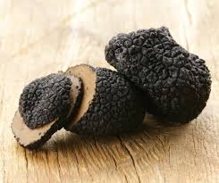
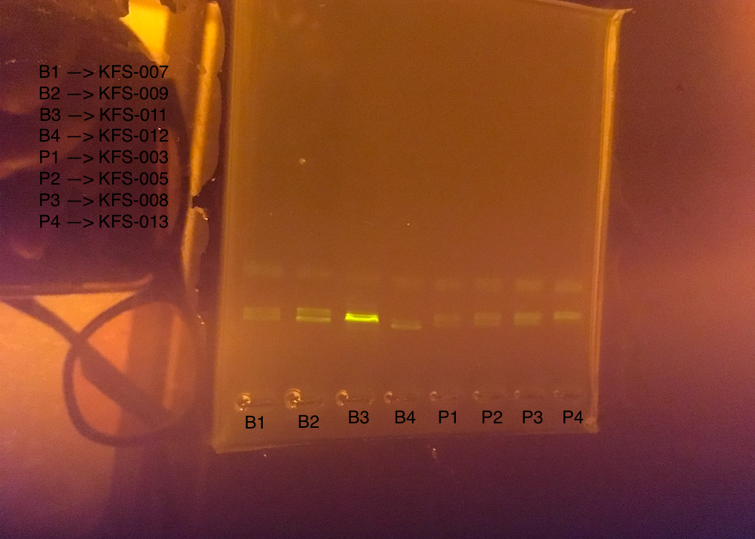
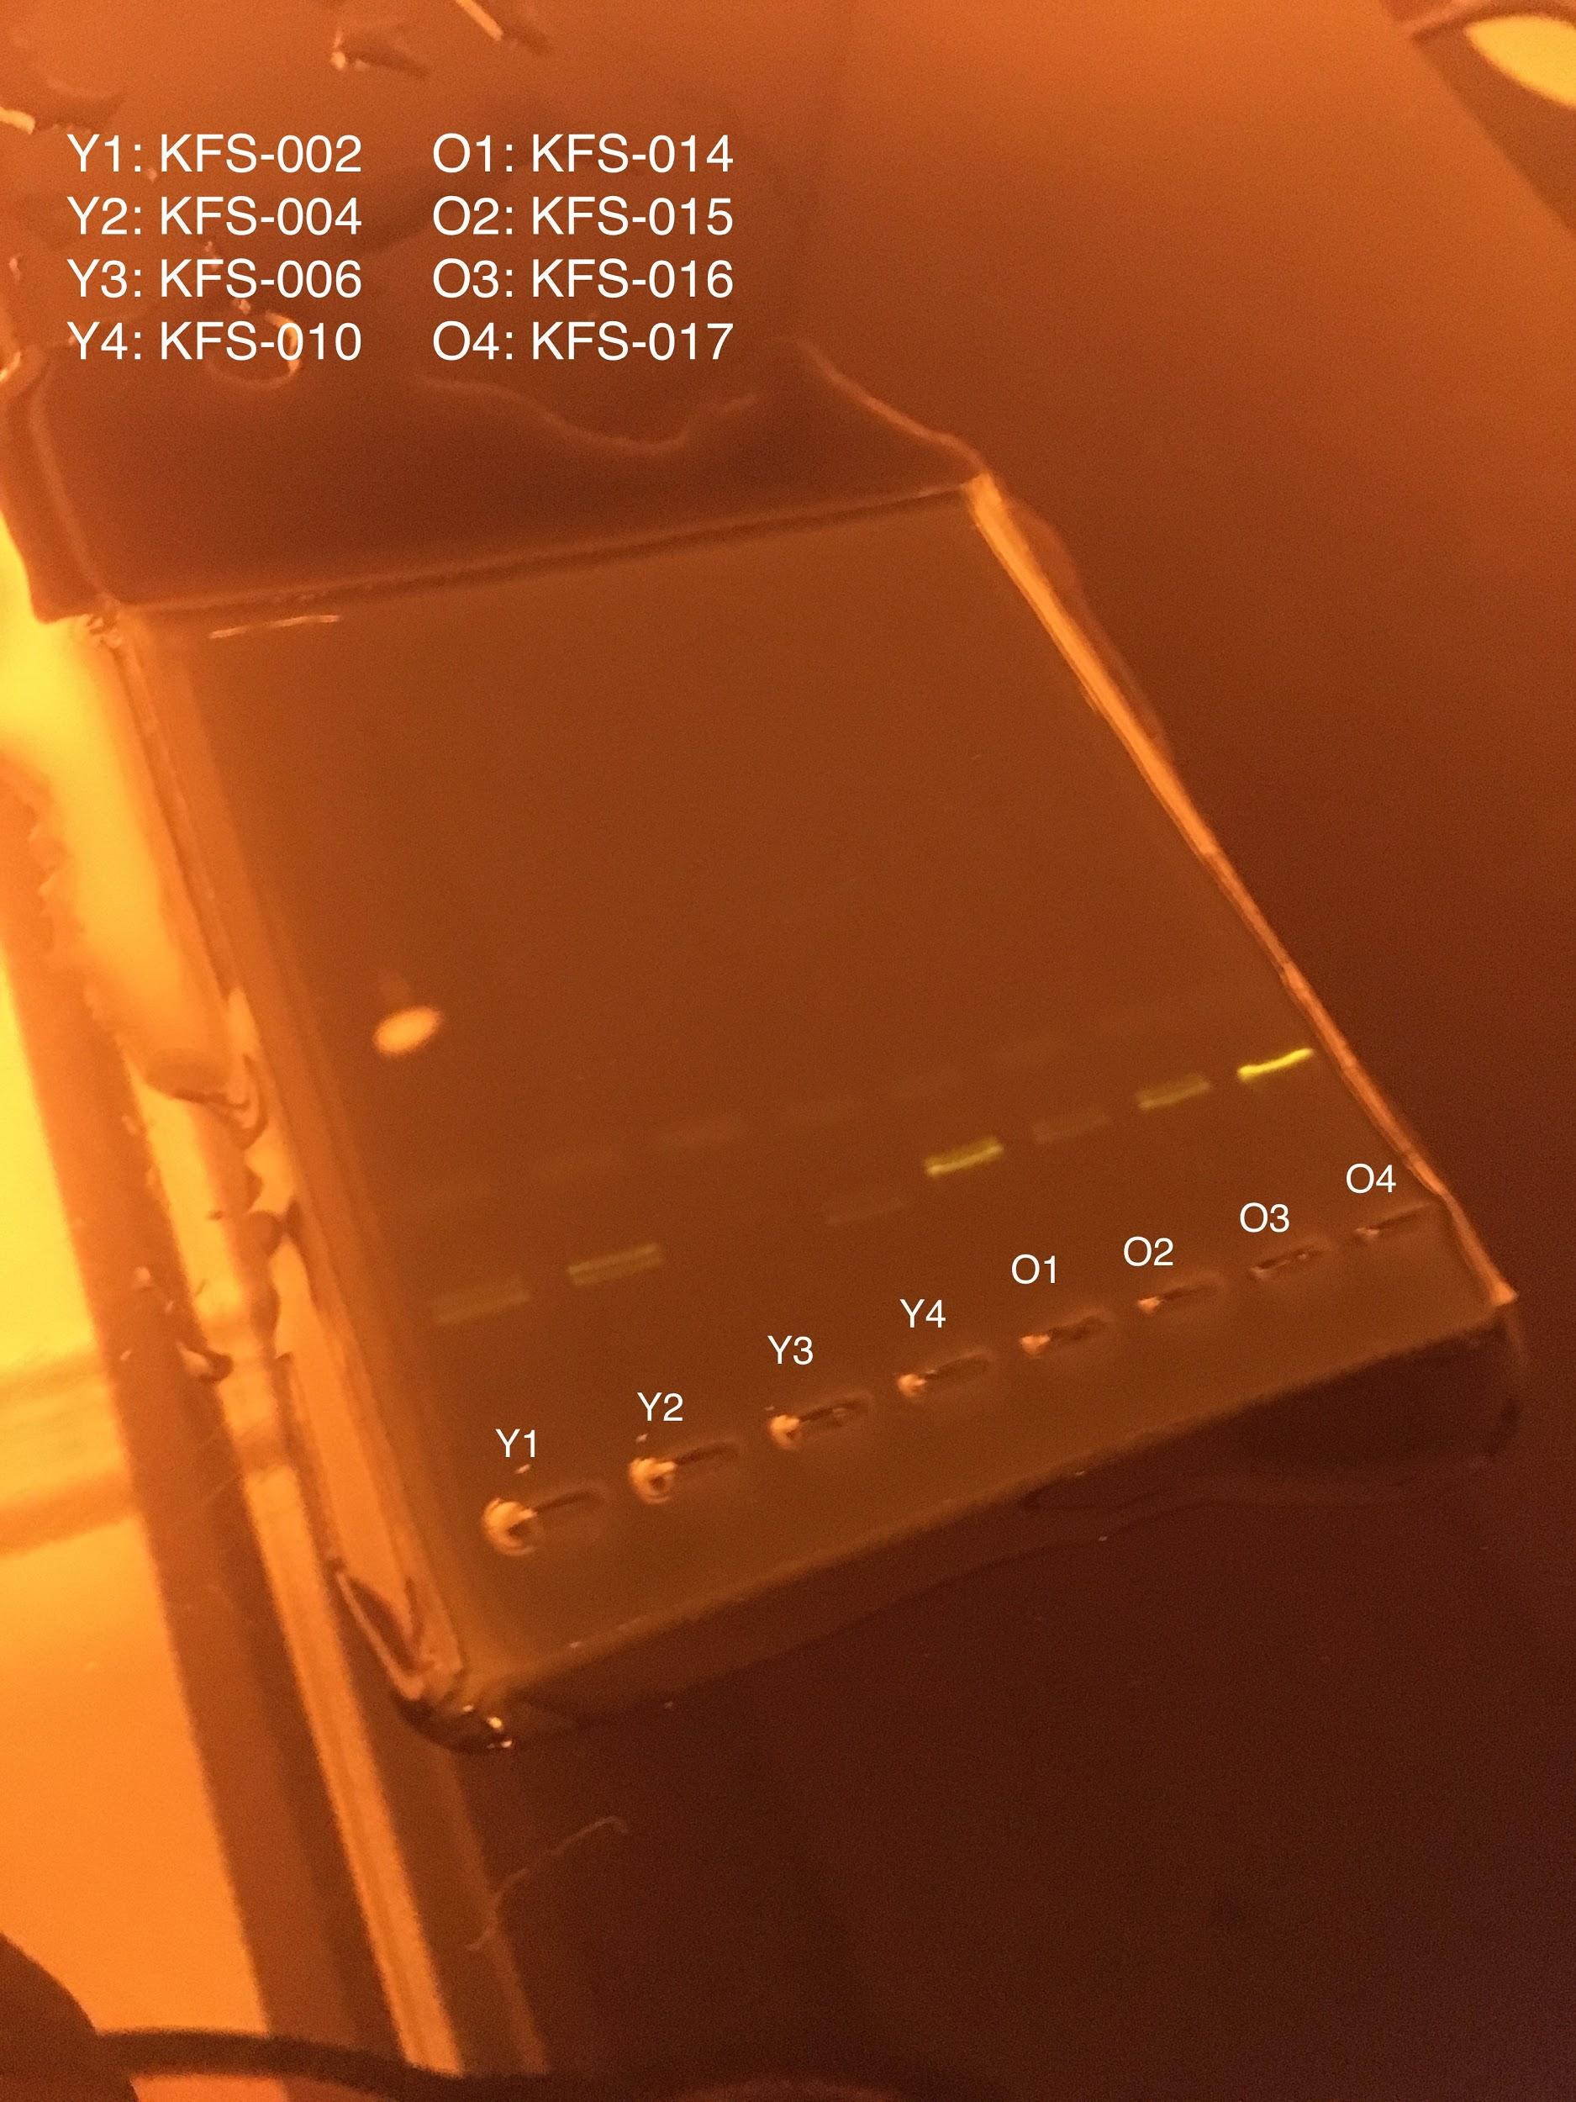
Truffle Fraud?
Zoe Balestri, Neeky Yassari, Isabella Zappi, Joelle Windmiller
Mentor: Howard Waldman
Materials & Methods:
Sampling:
Criteria: Species and Price
When: December 2015
Where: Internet and donated from teacher
What: ‘Perigord’ French Black Truffle (Tuber Melanosporum) and Chinese Black Truffle (Tuber Indicum)
How: Mail
Number of Samples: 4
Primer used: ITS primer
Methods: The Urban Barcode Project DNA Extraction protocol and procedure.
Discussion:
When the gels were run, there were both primer dimer and DNA bands indicating that there was viable DNA, but when the DNA was sent to the lab to get sequenced, no results were obtained, which is very strange. PCR conditions are not the same as sequencing conditions, that is probably why some samples amplified nicely and others did not sequence well. One explanation for this trend is that practically all of these samples showed two bands after the gel electrophoresis. It was assumed that one of the bands was a primer dimer band and would not interfere with the results of the sample band. However, this assumption may have been misleading, as the primer dimer band may have impeded upon our sample results. When there is a double band two DNA fragments are amplified. These two DNA bands are sequenced at the same time, which causes overlap and creates difficulty in identifying the gene. To avoid this problem in the future one may choose to use different fungal primers in their procedure, increase the annealing temperature in PCR, or add an additional chemical that would inhibit excess binding.¹
Abstract:
The purpose of this lab is to analyze the genetic sequence of a specific gene on Tuber Melanosporum, Tuber Sinensis, Tuber Indicum, and Tuber Himalayensis truffles to determine if there is fraud in the truffle industry. This was accomplished by examining the genetic makeup of different truffle samples through DNA sequencing. Unfortunately, accurate DNA results were not acquired, due to a unique trend specific to fungi.
Gels/Results:
The images from the gel electrophoresis did, indeed have bands, but when the DNA was sent to the lab to be sequenced, no DNA match was found.
Intro:
Truffles are considered a delicacy all around the world and are sold at exorbitant prices. There are numerous kinds of truffles from many different places, but one of the most luxurious truffles is the ‘Perigord’ French Black Truffle (Tuber Melanosporum), also called black diamonds. These truffles are very rare and are only found in a couple places on earth. Another type of truffle is not at all as expensive and is very common. This is the Chinese Black Truffle, which actually consists of three different species: Tuber Sinensis, Tuber Indicum and Tuber Himalayensis. These French and Chinese truffles look very similar, but taste very different and are very differently priced. Chinese Black Truffles can be sold for as little as $20 to $30 a pound, whereas Perigord French Black Truffles start at $800 per pound. As mentioned in a New York Times article by Florence Fabricant, some truffle dealers have been mixing these cheap, and tasteless Chinese Black Truffles with the precious French Black Truffles in order to make a larger profit. The implications and repercussions of this fraud are obvious. To combat this widespread fraud, France’s National Institute of Agronomic Research created a genetic coding test that looks at their DNA to decipher between the two species. Therefore, truffles make an interesting food fraud topic to do DNA barcoding with.
Acknowledgements/Bibliography:
Melissa Lee’s email explanation
http://www.first-nature.com/fungi/tuber-melanosporum.php
http://www.eatlovesavor.com/distinguishing-between-perigord-black-truffles-and-chinese-black-truffles
http://www.nytimes.com/1995/02/15/garden/the-invasion-of-the-chinese-truffle.html
http://www.urbanbarcodeproject.org/files/using-dna-barcodes.pdf

