Slide 1
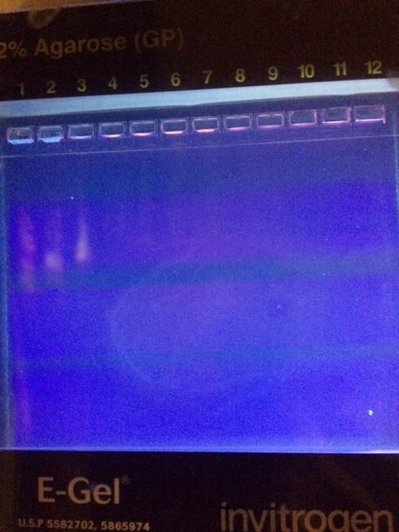
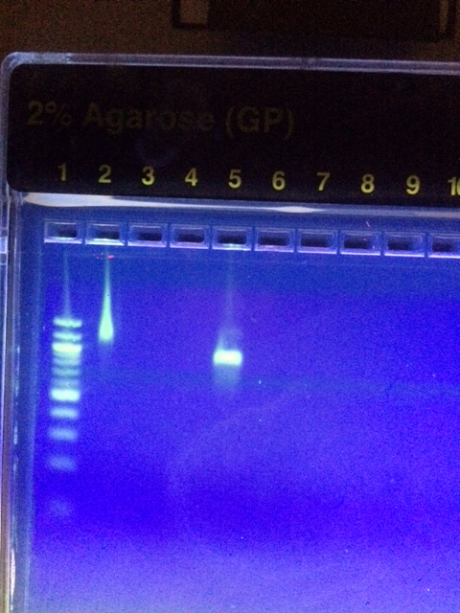
Hot Dog! You fooled me! Using DNA Barcoding to Detect Animal Protein in Vegetable Hot Dogs
Authors: Ginger Atwood and Juliette Lilly; Mentor: Vanaja Zacharopolous, PhD
Friends Seminary, New York
Abstract
The problem of food adultery, or the mislabeling of food products, has been brought to light recently. While an abundance of industries have been victimized by these adulteries in recent years, the vegetarian hot dog industry has been brought under fire after Clear Food, a Californian food analytics startup, found 14% of their tested vegetarian hot dogs to contain animal DNA. Our aim was to test brands of vegetarian hot dogs from the East Coast for the presence of vertebrate DNA. Samples were processed for DNA barcoding using standard procedures. Both plant and vertebrate primers were used in the amplifications. Our results showed that no vertebrate DNA was detected in the samples we tested.
Introduction
Hot dogs are one of the most loved American foods. According to the National Hot Dog and Sausage Council, Americans consume an estimated 20 billion hot dogs per year. Additionally, in 2014, American consumers spent over $2.5 billion on hot dogs. With increased awareness of healthy food, however, some Americans want to eat hot dogs without the meat, opting for vegetarian hot dogs. Vegetarians make up 3.2% of the American population and 31%⁹ are concerned with food safety ⁸. Vegetarian hot dogs claim to be produced entirely from products that do not contain meat. The meat is replaced with soy or other grain or legume products.
Food adultery is becoming increasingly common in the American food industry. Along with hot dog adulteration, there has been food adulteration in a number of products such as vanilla extract and olive oil.⁶ This adultery encompasses both the mislabeling of meats and dairy products. This was problematic as 2.5% of the American population ⁵ is allergic to dairy. In addition to companies adding ingredients that could cause consumers to suffer allergic reactions, in the case of vegetarian hot dogs, ethical and religious reasons come into play.
Hot dogs are currently a topic of discussion as a recent study conducted by Clear Food, a food analytic startup located in California, concluded that up to 14% of the 21 vegetarian hot dog brands that they tested contained, not only animal DNA but human DNA in a few samples. Because this study was conducted in California, we intended to test hot dogs that are primarily sold on the East Coast. Our mission was to determine whether or not the vegetarian hot dogs we tested contained animal products.
Materials & Methods
Three brands of vegetarian hot dogs were selected and processed for DNA barcoding. The sample number, the date purchased, location, and brand were recorded. Photographic documentation of the samples was conducted.
DNA was extracted from the filling of the hot dogs, avoiding the skin of the hot dogs. We used common methodology for DNA extraction, PCR amplification and gel electrophoresis, provided by the Urban Barcode Project. The silicon dioxide DNA purification method was followed. For PCR amplification, primers for the CO1 segment in animal mitochondrial DNA was used as well as plant primers (rbcL gene). The amplified sequences were electrophoresed to verify proper amplification of the sequences of interest. For our positive control, primers for the rbcL segment in plant mitochondrial DNA were used. Amplified DNA samples were frozen until ready for sequencing.
Once we received the sequenced data we compared and contrasted the DNA of vegetarian hot dogs from different brands to see whether or not animal DNA was present and noted differences between brands. We used the program on DNAsubway.org in order to analyze the sequenced DNA.
Figure 1 Figure 2
Figures 1 and 2 are pictures of the gel electrophoresis that we performed on our amplified DNA samples. Lane 1 in both figures is the DNA ladder. In figure 1, lane 2 and 3 are both sample one. In figure 2, lane 3 and 4 are is sample 2 and lanes 2 and 5 are sample 3. The results show that samples one and three showed positively for plant DNA, but negatively for animal DNA. This indicates that there was little DNA degradation but that there was definitively no animal DNA present. Sample two showed DNA degradation, as it did not move through the gel, thus we cannot confidently conclude whether or not there was animal DNA present.
We then sent in our DNA to Genewiz for sequencing. The data concluded that in sample 1, no animal DNA was identified, as we had predicted. However, bacterial DNA was identified. In sample 3, no animal DNA was identified, as we had predicted. However, bacterial DNA was identified. The identification of bacteria in these two samples may be from contamination during handling. For sample 2, too much DNA degradation took place, leaving our results inconclusive.
For samples one and three, we identified plant DNA by BLAST analysis, primarily wheat (Triticum aestivum) and a range of bacterial types. In sample 2, we did not obtain sufficiently clean sequencing data due to DNA degradation.
Discussion
Our hypothesis was rejected as we did not identify any animal DNA in the samples tested. Our primary hurdles were a small sample size and DNA degradation. Had we conducted extractions on more samples, it is possible that we may have found animal DNA, but with the samples we took we did not find any. Our definite negative results pose a positive impact for the vegetarian community, as they confirm the safety of vegetarian hot dogs for the vegetarian community. Testing more brands and conducting the same extractions multiple times would be beneficial to building on our findings.
Out of our three samples, one of the samples was inconclusive due to DNA degradation. The research we had done before conducting our experiment lead us to believe that a small percentage of all vegetarian hot dogs contained animal DNA. In retrospect, due to our small sample size, it was unlikely that we were going to find animal DNA. Also, we realized after we had purchased two brands of the hot dogs that they were separate lines of hot dog sold by the same parent company. This further decreases the likeliness of us finding animal DNA in the hot dogs. Finally, we did not vary the stores that we purchased our hot dogs from enough. We shopped at stores that we would have believed to be credible instead of stores that were less known and were more likely to contain products with questionable ingredients. With continued research and a larger sample size, our findings could be significantly built upon in a positive way.
References
1:"Clear Food - The Hot Dog Report." Clear Food. Web. 18 Nov. 2015. <http://www.clearfood.com/food_reports/2015/the_hotdog_report>.
2:"Searching History For The Hot Dog's Origin." NPR. NPR. Web. 18 Nov. 2015.
<http://www.npr.org/2011/07/04/137530290/searching-history-for-the-hot-dogs-origin>.
3:"Hot Dog Fast Facts." Hot Dog. Web. 18 Nov. 2015.
<http://www.hot-dog.org/culture/hot-dog-fast-facts>.
4:Wong, Venessa. "The Future of Kraft's Mislabeled, Recalled Oscar Meyer Cheese Dogs." Bloomberg.com. Bloomberg. Web. 18 Nov. 2015
<http://www.bloomberg.com/bw/articles/2014-04-22/when-a-hot-dog-recall-brings-back-safe-food-where-does-it-go-next>.
5: Renter, Elizabeth. "96,000 Pounds of Mislabeled Kraft Hot-Dogs Recalled for Allergen Risks." Natural Society. N.p., 28 Apr. 2014. Web. 18 Nov. 2015. <http://naturalsociety.com/mislabeled-kraft-hot-dogs-recalled-allergen-risks/>.
6: Dybuncio, Monica. "Food Frauds: 10 Most Adulterated Foods." CBSNews. CBS Interactive, 22 Jan. 2013. Web. 18 Nov. 2015. <http://www.cbsnews.com/media/food-frauds-10-most-adulterated-foods/2/>.
7:"Experiment Protocol | DNA Barcoding 101." Experiment Protocol | DNA Barcoding 101. N.p., n.d. Web. 18 Nov. 2015. <http://www.dnabarcoding101.org/protocol_analyze_pcr_products.html>.
8:"Vegetarianism In America." Vegetarian Times. Cruz Bay Publishing. Inc., n.d. Web. 18 Nov. 2015. <http://www.vegetariantimes.com/article/vegetarianism-in-america/>
Acknowledgements
Vanaja Zacharopolous, our project’s mentor, helped us to understand how to perform extractions. Vanaja also helped us decide on our project’s subject. The faculty at the Cold Spring Harbor DNA Lab initially taught us to extract DNA.
Sample Number | Store Purchased At | Brand | DNA Identified | Animal Protein?
1 | Major Grocery Chain | Whole Foods Brand (365 brand) | Bacteria | No
2 | Local Market | Lightlife Smart Dogs | None | Inconclusive
3 | Local Market | Lightlife Smart Dogs | Bacteria | No

