Slide 1
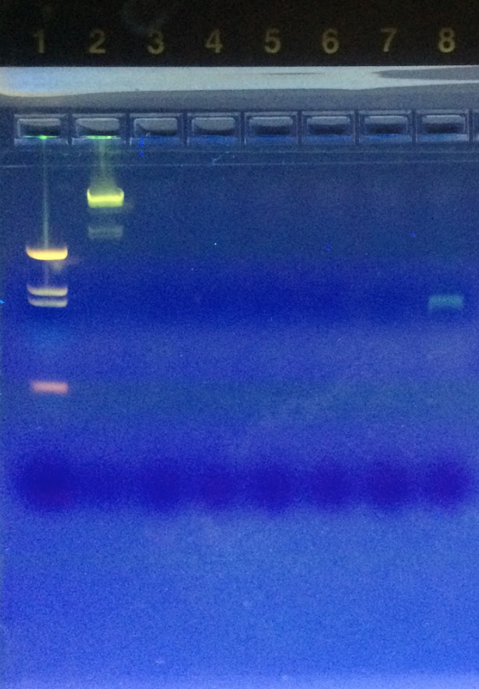
Something to Smile About: DNA Barcoding of St. John’s Wort Herbal Supplements
Authors: Justin Rubino, Gus Moody
Mentor: Vanaja Zacharopoulos, PhD
Friends Seminary
Abstract
St. John’s Wort is an herb commonly used as a remedy for depression and related conditions. This work addresses the question of whether St. John’s Wort capsules purchased at health food stores actually contain St. John’s Wort or if other substances are present in the capsules. This was determined through DNA barcoding. We first took samples of the powder from the capsules of the different brands of herbal supplements we were testing and performed a DNA extraction on them. The extracted DNA was then amplified through PCR and plant primers (rbcl). Gel electrophoresis was used to separate the bands of DNA, and positive samples were sequenced. Multiple efforts to extract DNA from the supplements proved unsuccessful, and we were unable to extract any DNA. We concluded that there may be problems with the extraction of DNA from herbal supplements.
Introduction
Our goal was to characterize the ingredients of commercially available St John’s Wort capsules to see if adulteration was present in this product.
We were not only looking for the presence of St. John’s wort in these supplements, but also the presence of other plant species and any ingredients not listed on the packaging of the supplements.
In this project we tested the hypothesis that St. John’s Wort capsules do not contain the herb St. John’s Wort.
Materials & Methods
Samples of St. John’s Wort supplements were collected including capsules and dry leaf tea bags, but due to technical difficulties we focused on dry powder capsule herbal supplements
Samples were from Nature’s Way St. John’s Wort Herb Premium Extract, GNC St. John’s Wort Standardized Extract, and Nature’s Way St. John’s Wort Standardized Premium Extract.
We used the common methodology for DNA extraction, PCR amplification, and gel electrophoresis, provided by the Urban Barcode Project.
Approximately half a capsule, or 175 mg, was used to extract DNA from in order to increase the chances of us being able to extract DNA.
After extracting the DNA, we amplified the DNA using polymerase chain reaction. Amplified sequences were electrophoresed to verify proper amplification of the sequence of interest.
We then put each St. John’s sample into designated wells in an agarose gel, along with the plant control sample and a DNA ladder and applied electric voltage to the gel to separate the DNA strands by length.
We then took the fully run gel and put it under a blacklight to see if our samples contained DNA.
Because we did not yield any DNA from the above process, we did not send our samples out for sequencing
Results
After extraction, PCR, and running our samples through the gel, we found no DNA in any of our three samples.
Tables & Figures
The image above shows the electrophoresis results of one trial. Lane 1 corresponds to the 100 bp DNA ladder, lanes 5 thru 7 correspond to our herbal supplements, and lane 8 corresponds to the plant positive control. As you can see in lanes 5, 6 and 7, no DNA fragments corresponding to 800 bp were observed, in contrast to the band from the positive control in lane 8. No samples were sent for a sequencing, as a result.
Discussion
Our experiments did not yield the expected results primarily due to our inability to extract DNA from our samples. Our ability to get a positive result in our positive control validated our procedures. Our results support the theory that there may not be St. John’s Wort herb in the supplements, a theory tested a proven in a study by the Genetic Literacy Project. Research by other investigators, however, revealed that herbal supplements frequently contain extracts which may not have any DNA in them, and are unidentifiable through DNA barcoding. Therefore, it is quire possible that if we had used a more biochemical or physiological method of investigation, such as fingerprint technology, we may have been able to detect the presence of St. John’s Wort in the herbal supplements.
References
O'connor, A (2013). Herbal Supplements Are Often Not What They Seem. The New York Times, Section Science. 1.
Powledge, T (2015).“DNA Testing Under Fire in Wake of Fake Herbal Supplements Investigation. .www.geneticliteracyproject.org/. Accessed. 5 May 2016.
Reynaud D.T. & Mishler, B (2013). The Capabilities and Limitations of DNA Barcoding. Authentechnologies: 1-9.
Acknowledgements
Thank you to Dr. Vanaja Zacharopoulos for mentoring, guiding, and helping us throughout this year-long process. Also thank you to Dr. Eileen Guilfoyle for suggesting ways to extract DNA more efficiently.

